Slide 1
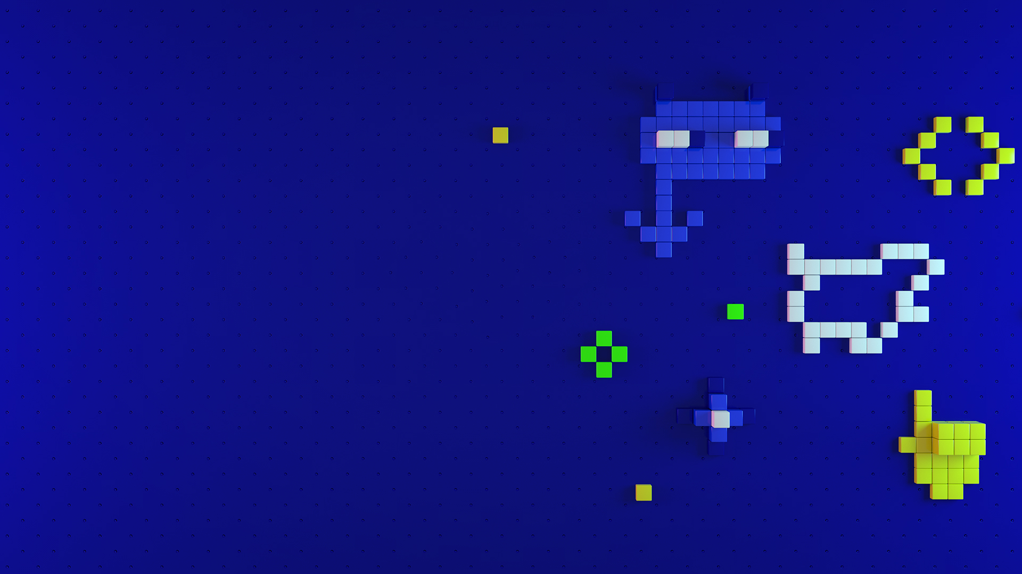
Panayot Cankov VR Quickstart with Unity 3D
Tue, 22 Oct | 4:40 PM – 5:30 PM
Alpha Room

Slide 2

What is Virtual Reality?
Fully enclosed, synthetic experience with no sense of the real world
Notes:
What is VR – a completely digital environment

Slide 3
Health & Safety
Security in Public Spaces
Play Space Guardian
Cyber Sickness
Injuries
Hygiene

Slide 4
Mobile VR Hardware Breakdown
Phones on steroids

Slide 5
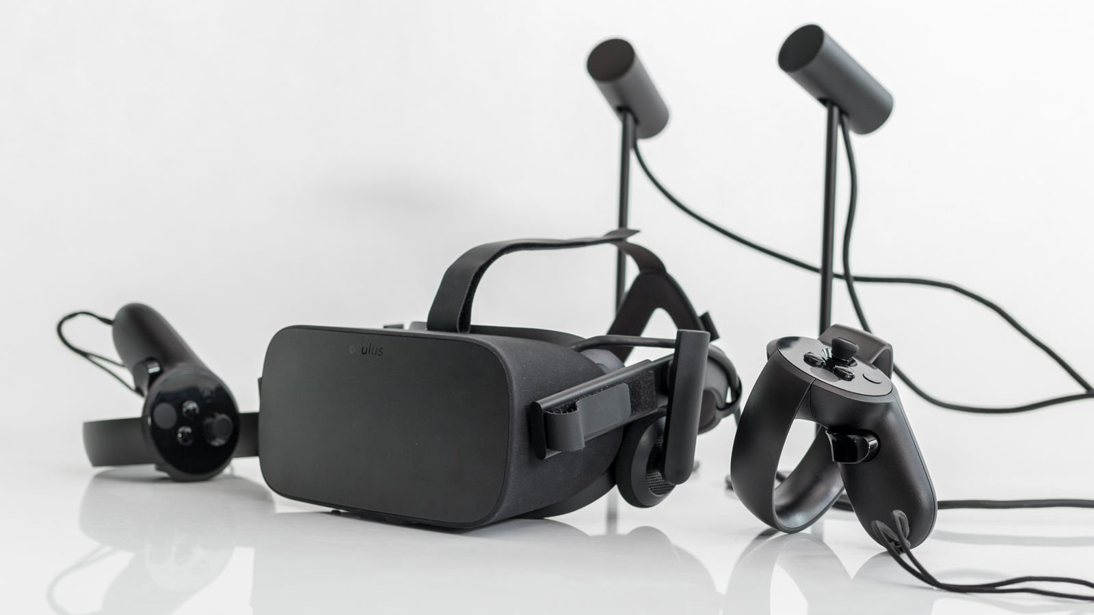
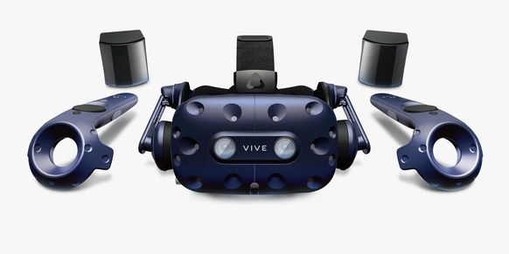
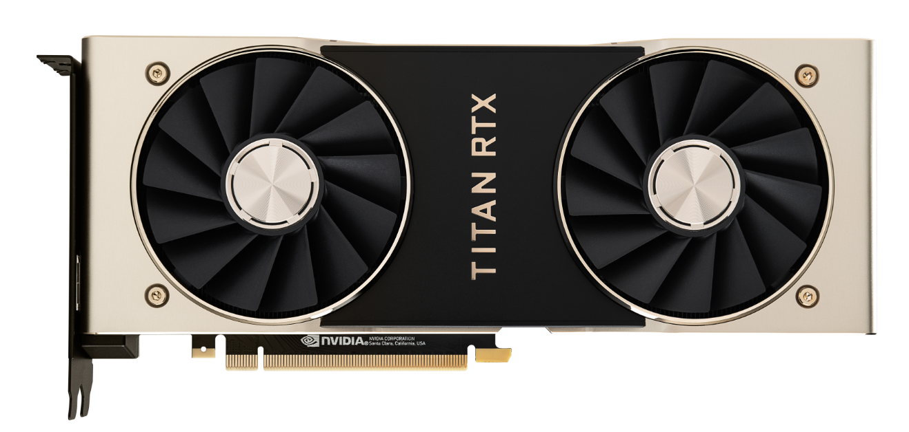
Tethered VR
Oculus Rift
HTC Vive Pro
PC GPU
+

Slide 6
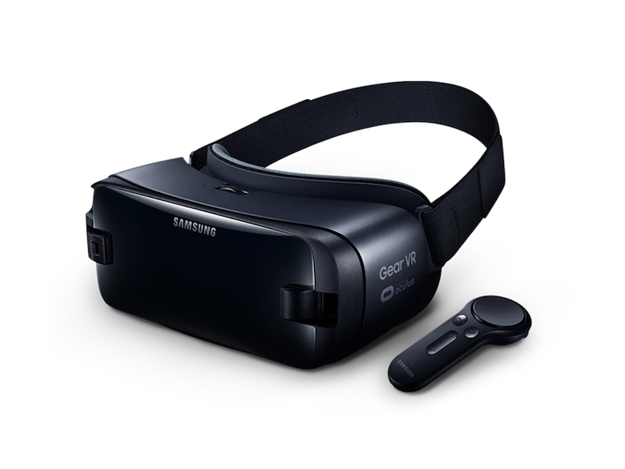
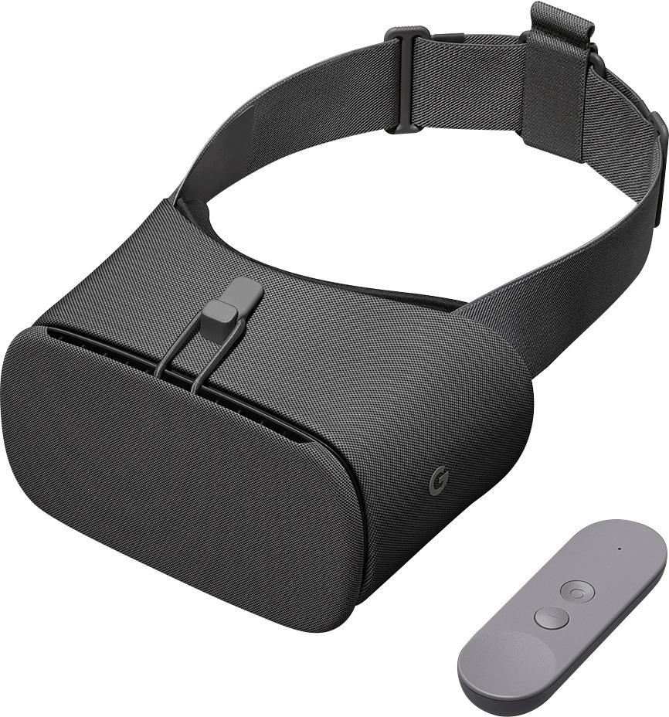
Slot-in VR
Google Daydream
Discontinued
Samsung Gear VR
Discontinued

Slide 7
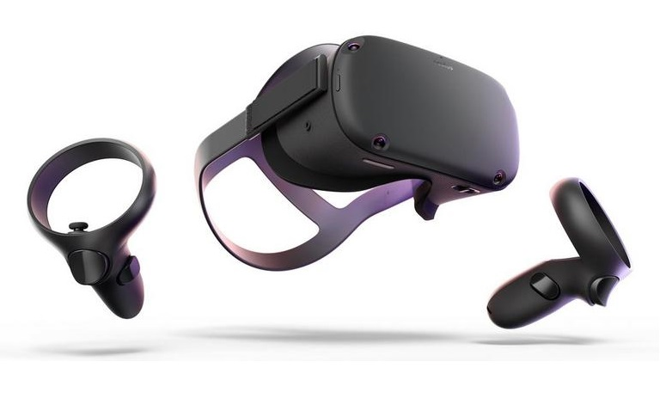
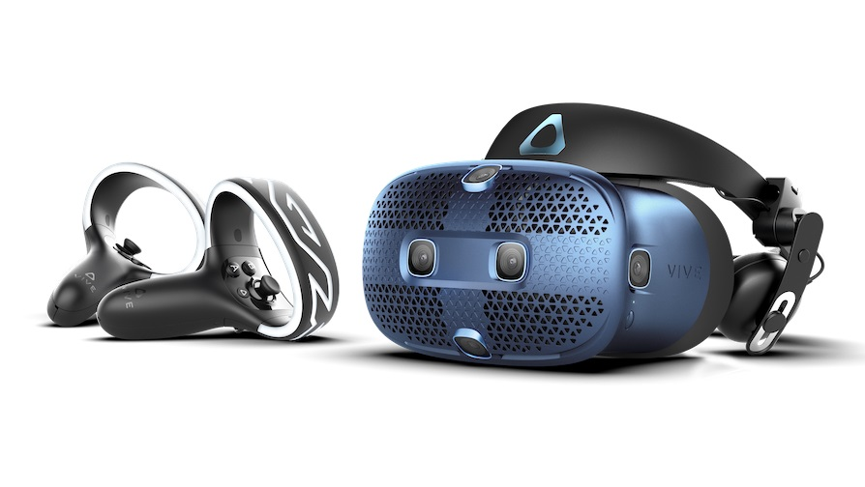
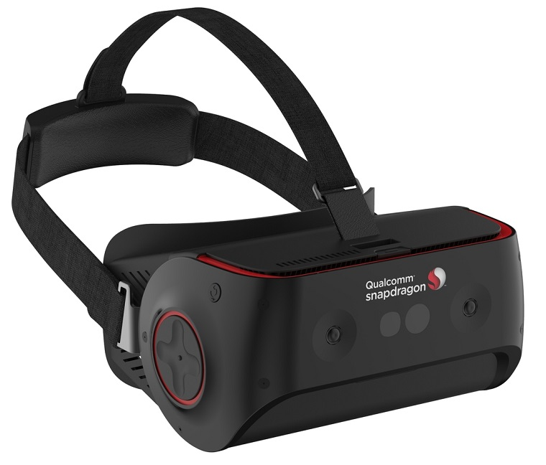
Mobile VR
Oculus Quest
HTC Cosmos
Snapdragon
Snapdragon 845 VR Development Kit

Slide 8
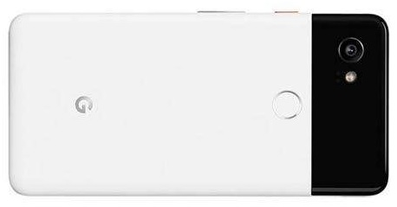
Mobile VR vs Mobile Phone Hardware
Oculus Quest
Qualcomm Snapdragon 835
OLED, 1440 x 1600 x 2, 72Hz
Adreno 540
4GB Ram
Li-ion battery (2-3 hours playtime)
571g
4 Monochromic Cameras
Android
Google Pixel 2 XL
Qualcomm Snapdragon 835
pOLED, 1440 x 2880, 60Hz
Adreno 540
4GB Ram
Li-Ion battery
175g
2 Cameras
Android

Slide 9
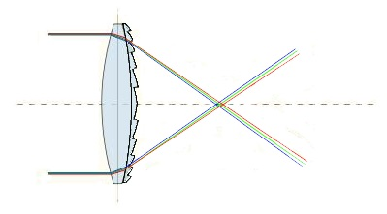
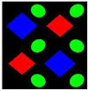
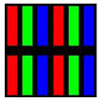
VR Displays
Stereoscopic
Fresnel Lens Optics
God Rays
Chromatic Aberrations
Diamond PenTile vs RGB Stripe
Ghosting Effect
Screen Door Effect
Fresnel Lens
DiamondPenTile
RGB Stripe

Slide 10
Oculus Quest
The future of mobile VR?

Slide 11

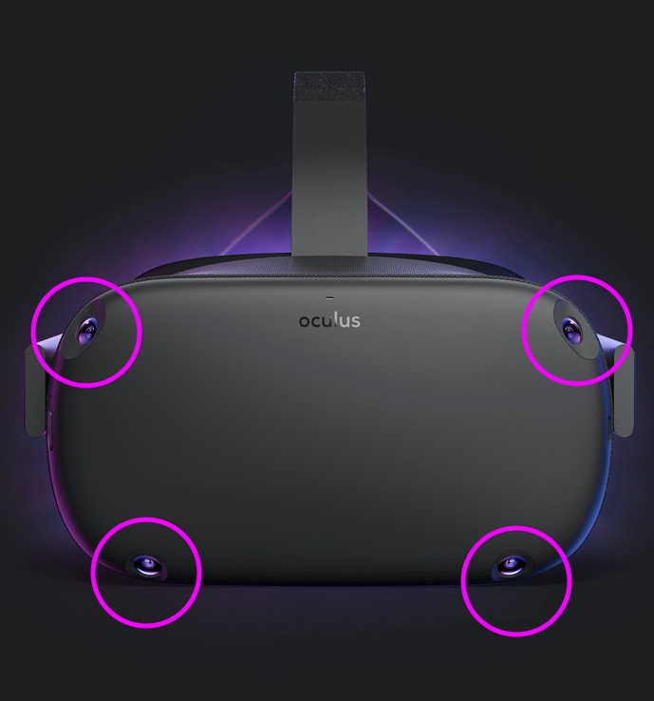
Quest Tracking
4 monochromic cameras
6DoF Inside-out tracking
6DoF Controllers tracking
Play Area Guardian

Slide 12
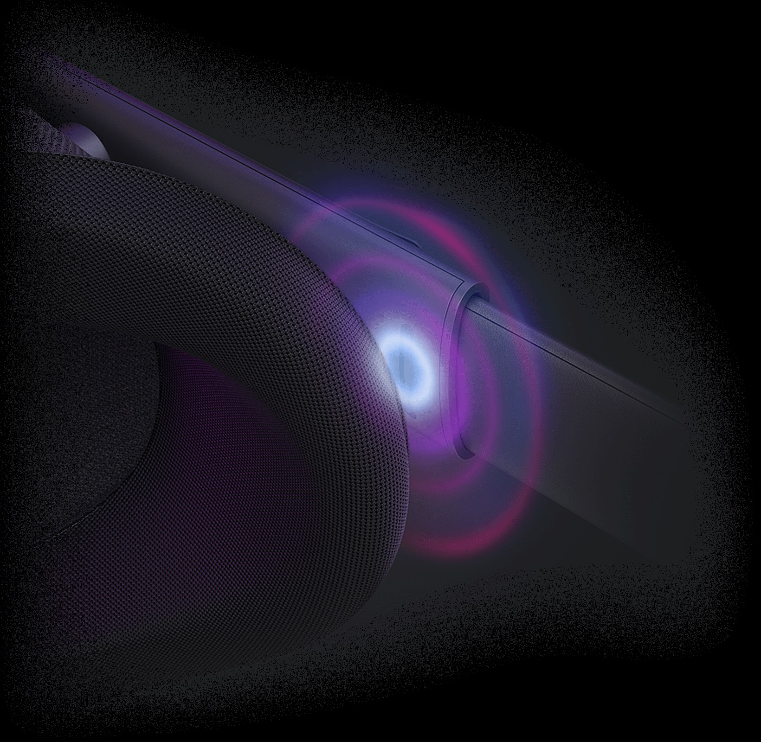
Quest Audio
Built-in Headset speakers
Over-the-ear waveguide
Positional Audio

Slide 13
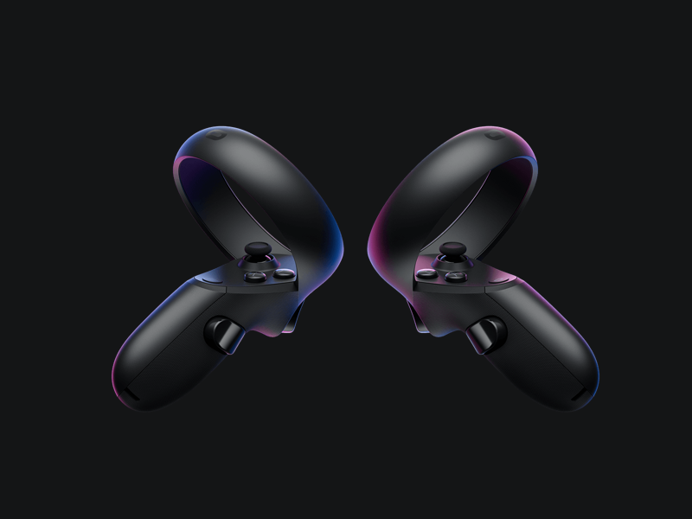
Quest Controllers
6DoF
2 Top Buttons
Joystick
Trigger Button
Grip Button

Slide 14
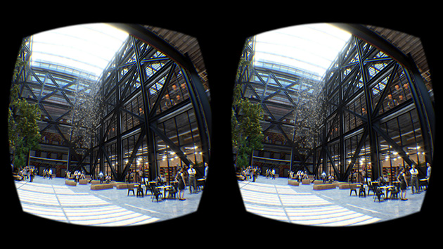
Stereoscopic View

Slide 15
VR Rendering

Slide 16

2D Rendering
Crisp texts
What you see is what you get
Good anti-aliasing
High angular resolution

Slide 17
VR Rendering
Timewrap reprojects the rendered image
Low angular resolution
Expensive antialiasing
3D rendering

Slide 18

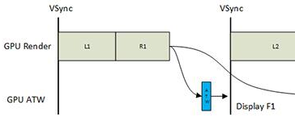
3D VR Rendering
Asynchronous Timewarp
x1.33+ supersampling
Timewarp transforms the rendered image,
to significantly reduce the motion-to-photon delay

Slide 19
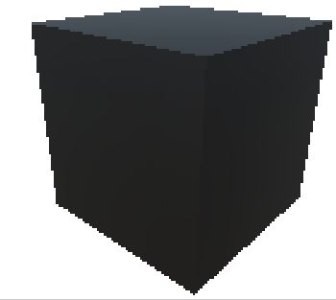
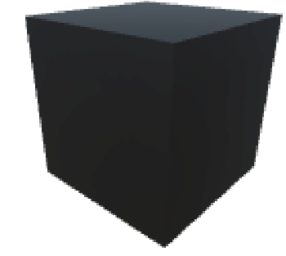
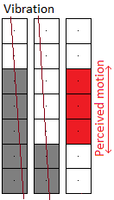
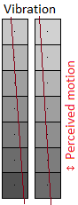
3D VR Rendering
Jitter
Use x4 MSAA! ~ 5 shades of gray
No AA
Perfect AA

Slide 20
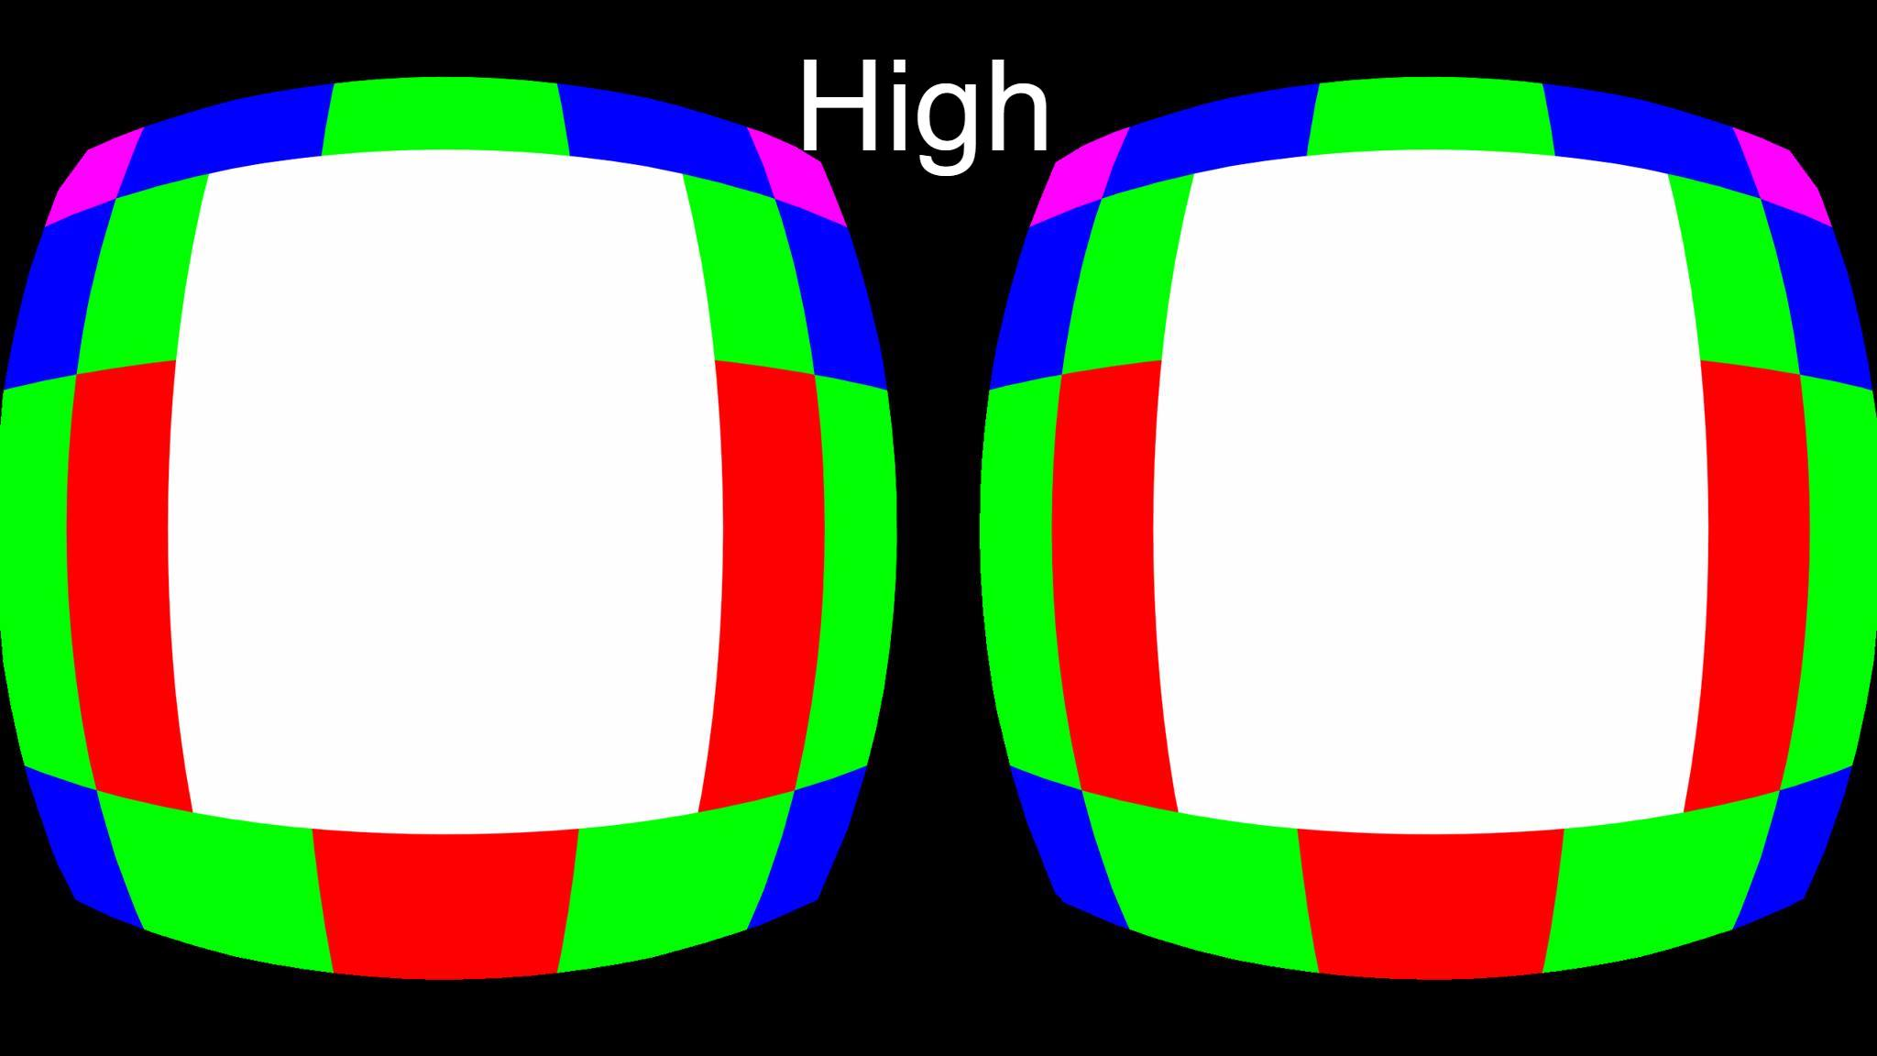
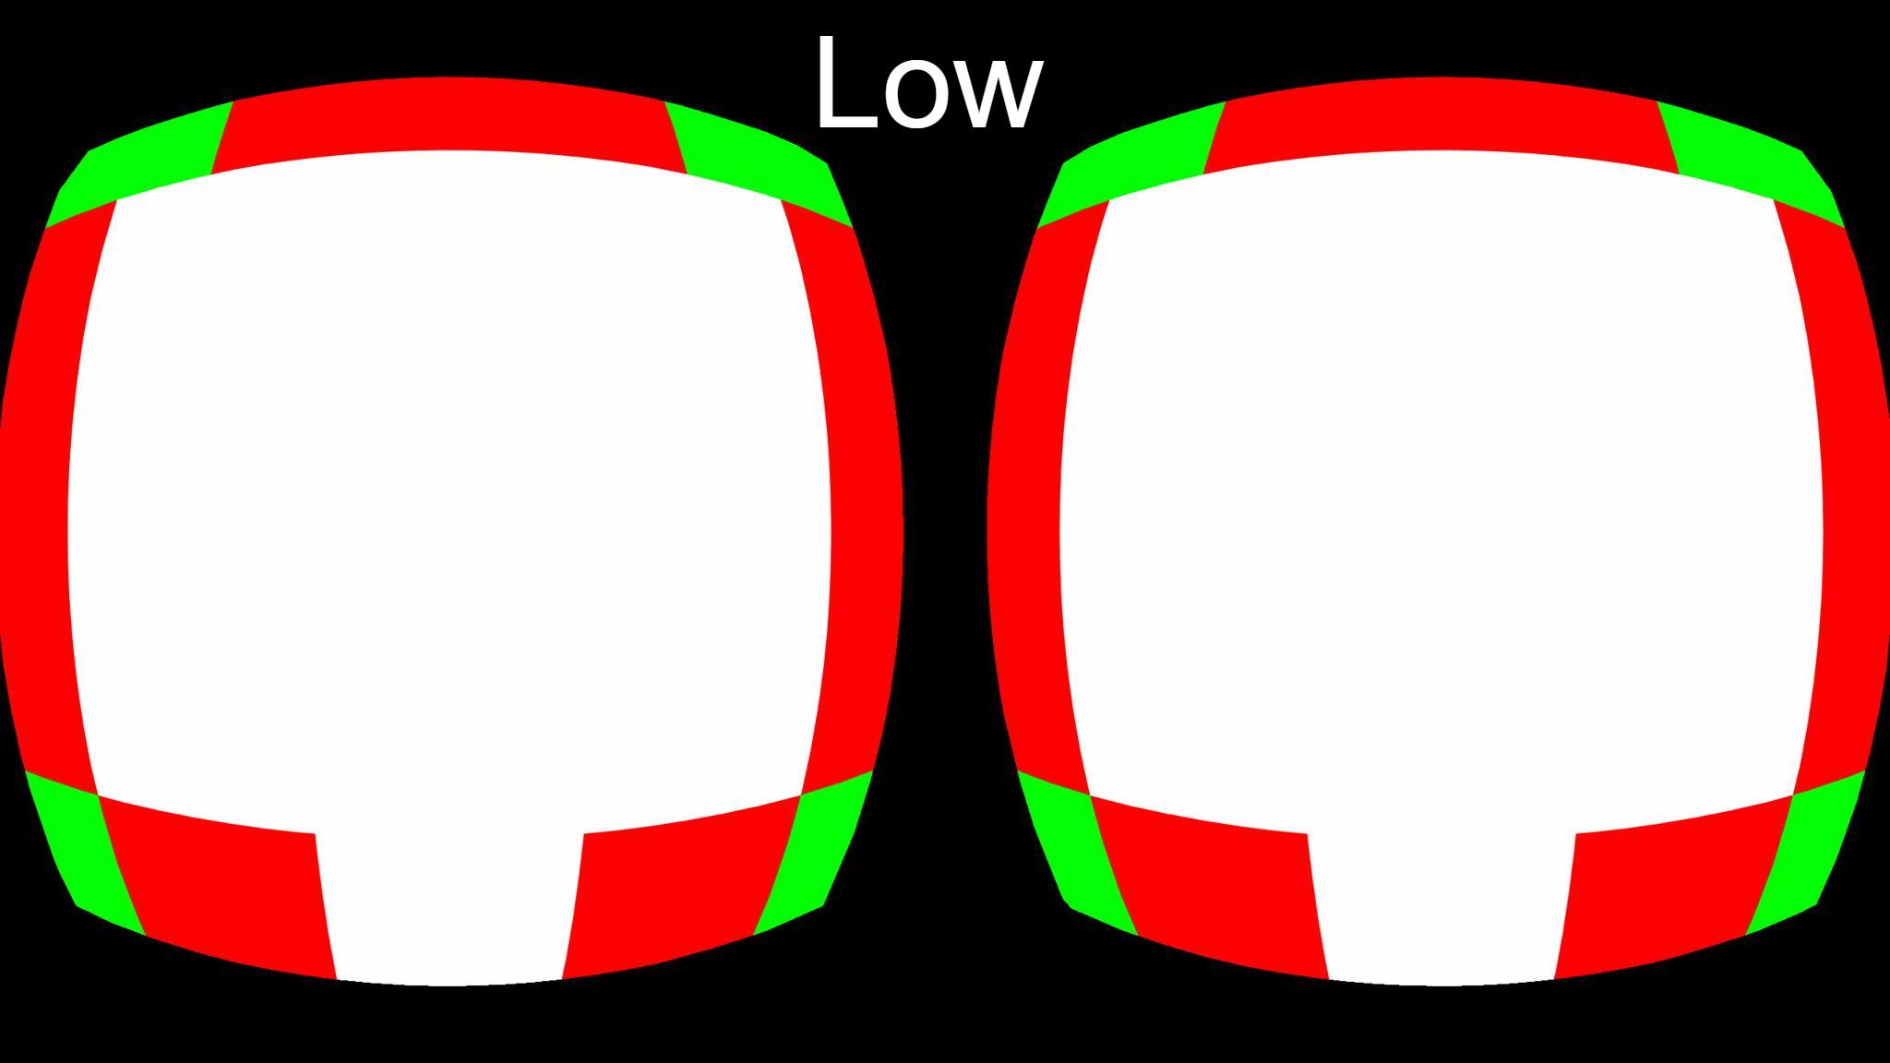
Oculus Quest
Fixed Foveated Rendering
Optionally degrade rendering resolution by the edges
60hz vs 72hz
At 60hz:
- Screen “Flickering”
- More prone to nausea
At 72hz:
- It is usually better

Slide 21
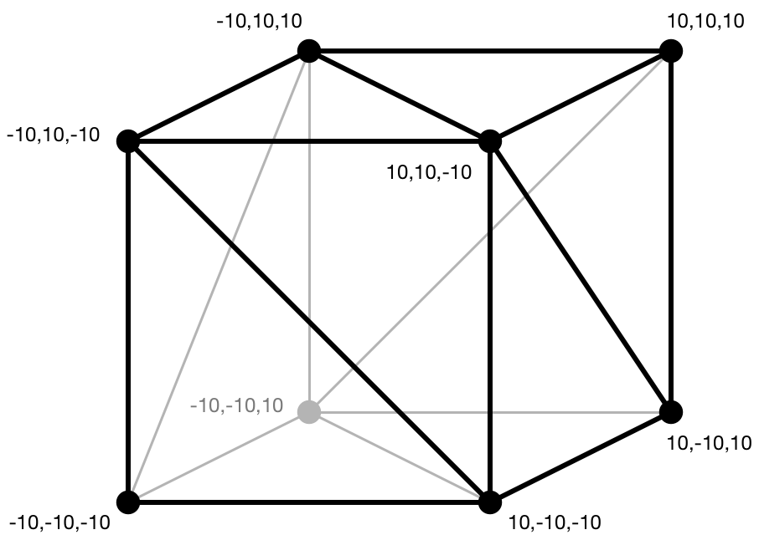
3D Meshes
Vertices Buffer
Array of points, each point has:
Position - local coordinate
UV coordinates - texture position
Normal – used for lighting
Other
Triangles
Each triangle has a triple of vertex indices

Slide 22

Drawing a Mesh
Vertex Shader
Executes for each vertex. Transform vertices from object coordinates to screen coordinates.
Pixel Shader
Executes for each pixel a triangle covers. Calculates the pixel color, usually by sampling texture.

Slide 23
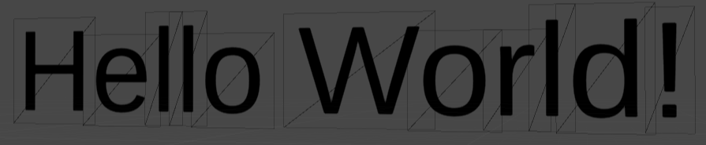

3D UI & Text Rendering
Quads
2 triangles forming a rectangle draw a texture
Text
A quad draws a letter
SDF (Signed Distance Field)
PixelShader variant renders antialiased shapes based on special textures. ~256 shades of gray.

Slide 24


VR Stereo Rendering
Normal
Single-pass

Slide 25
Unity 3D

Slide 26
Getting Started
Download
https://unity3d.com/get-unity/download
Install Unity Hub
From the Unity Hub install Unity version with Android SDK
Documentation
https://docs.unity3d.com/Manual/
Oculus
Oculus Integration, Oculus Documentation https://developer.oculus.com/downloads/package/unity-integration/

Slide 27
C# Classes
GameObject
Has name. Can be activated/deactivated. Has collection of components. Has exactly one transform.
MonoBehaviour
MonoBehaviour inherits Behaviour and Component. Has special lifecycle events: Awake, Start, Update, etc.
Transform and RectTransform
Has position, rotation and scale.
Inherits Component. Has reference to a single GameObject. Has collection of child transforms.
Other
MeshRenderer, MeshFilter, Collider, Rigidbody, Light, Camera

Slide 28
Tracking
MainCamera
VR enabled Unity project will auto update main camera’s position and rotation
InputDevice
UnityEngine.XR.InputDevice – a common API, for all VR platforms

Slide 29
Hands On
Unity Hub > Unity, new project. IDE layout, what is Hierarchy, Project, Inspector, Console, Scene and Game, Asset Store.
Project settings, quality, VR enable, 4x MSAA, no shadows, 1 light, single-pass rendering.
My first MonoBehaviour, ‘Quality’, set OVRManager.fixedFoveatedRendering, OVRManager.displayFrequency, XRSettings.eyeTextureResolutionScale, XRSettings.renderViewportScale, QualitySettings.antiAliasing.
Add Asset Store’s Milky Way Skybox.
Scenes, what is scene, serialization/deserialization play/edit modes. Prefabs, what is prefab, serialization/deserialization, editing and reusing prefabs. Move objects around. What is camera. Skybox.
Add hand prefabs from fbx. Add Rigidbody. HandTracking behaviour using InputDevice. IsKinematic. Rigidbody.SetPosition/Rotation. Add table, floor, balls with colliders.
Carry a big ball, it falls through my body? Add body collider, try to carry the ball.
Use buttons, add grabbing hand pose, enable grab button, implement grabbing small balls.

Slide 30
What is Next
Hands Tracking
Oculus Quest hands tracking
through software update
Oculus Link
PC to Quest streaming through USB-C
faster dev iteration cycles

Slide 31


Session Feedback Your Time & Opinion is Valued
https://www.telerik.com/devreach/day1feedback

